Slide 1

Team 1 - Sprint 5
SLW Home Improvements
Members
Carson Hatem – Systems Analyst
Austin Bing-Zaremba – Business Analyst
Christian Lancaster – Co-Product Owner
Jackson Ingalls – Database/Programming Coordinator

Slide 2
Migration Objectives
• Migrate all relevant customer data from spreadsheets to the new database.
• Ensure accurate transfer of service pricing and historical quote records.
• Train staff on system usage before full cutover.
• Minimize system downtime and disruptions to business operations.
• Establish temporary post-migration support

Slide 3
Migration Plan – Business Readiness
Stakeholder Buy-in – Ensure SLW Home Improvements' management and key staff are on board with new system
Data Preparation – Gather/Clean existing data (customer data, invoices, quotes) to upload into new system
Process Review – Compare current workflows to new system's flow to ensure alignment
Communication Plan – Keep all staff updated with system launch

Slide 4
Business Readiness Success Indicators
• All customer and quote records successfully transferred.
• SLW staff perform all business tasks in the new system within 1 week.
• No interruption in customer service during migration.

Slide 5
Migration Plan – Technical Readiness
System Hosting – Set up the web server and ensure that the database is deployed correctly
Security Setup – Implement user authentication, admin access, and secure backups
Testing – Perform functionality tests, bug checks, and ensure all forms work correctly
Data Migration – Upload the cleaned data to the new system
Backup Plan – Create a website and database backup files

Slide 6
Technical Readiness Success Indicators
• All components meet non-functional requirements.
• No critical bugs found in final pre-launch system test.
• Backup/recovery processes verified before launch.

Slide 7
Migration Plan – People Readiness
Training – Provide extensive training (considering that many operations were done by hand before), and provide technical manuals for employees
Support – Identify who staff can contact in case of problems during implementation
User Testing – Allow staff to test before system launch to build confidence and identify any unidentified issues

Slide 8
People Readiness Success Indicators
• 100% of staff trained and logged into the system before go-live.
• Positive feedback from test users regarding usability.
• Support requests are resolved within 24 hours during Week 1.

Slide 9
Post-Migration Support
Designate a migration support contact (Jackson Ingalls – Database/Programming Coordinator).
Track and prioritize reported issues.
Roll out patches or data fixes within 24–48 hours.
Hold a post-migration review meeting two weeks after go-live to make final changes if needed and receive feedback from users.

Slide 10
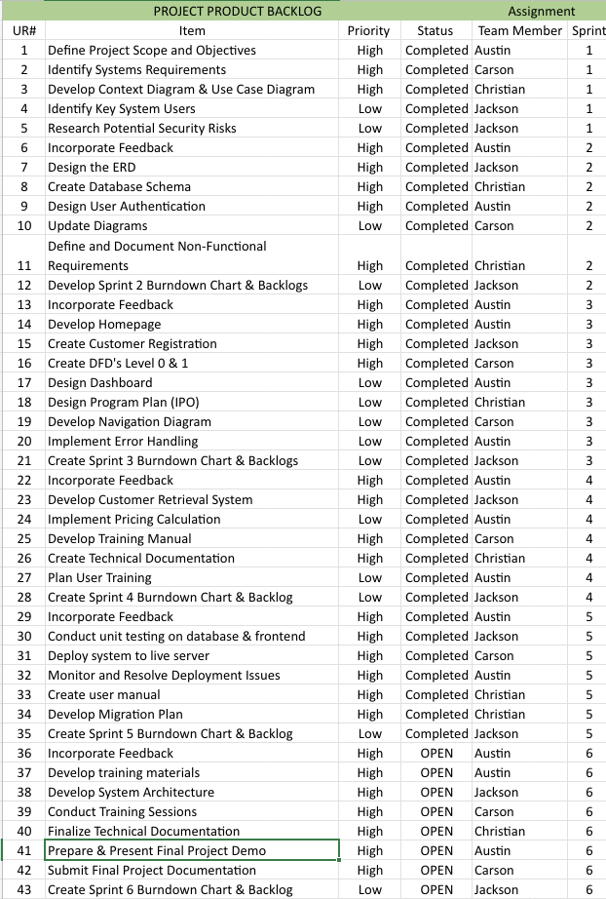
Updated Product Backlog

Slide 11
Sprint 5 Backlog
SPRINT 3 BACKLOG |  |  |  | Assignment
UR# | Item | Priority | Status | Team Member
29 | Incorporate Feedback | High | Completed | Austin
30 | Conduct unit testing on database& frontend | High | Completed | Jackson
31 | Deploy system to live server | High | Completed | Carson
32 | Monitor and Resolve Deployment Issues | High | Completed | Austin
33 | Client meeting to ensure the system meets all of their needs | High | Completed | Christian
34 | Develop Migration Plan | High | Completed | Christian
36 | Finalize Sprint 5 Burndown Chart & Backlog | Low | Completed | Jackson

Slide 12
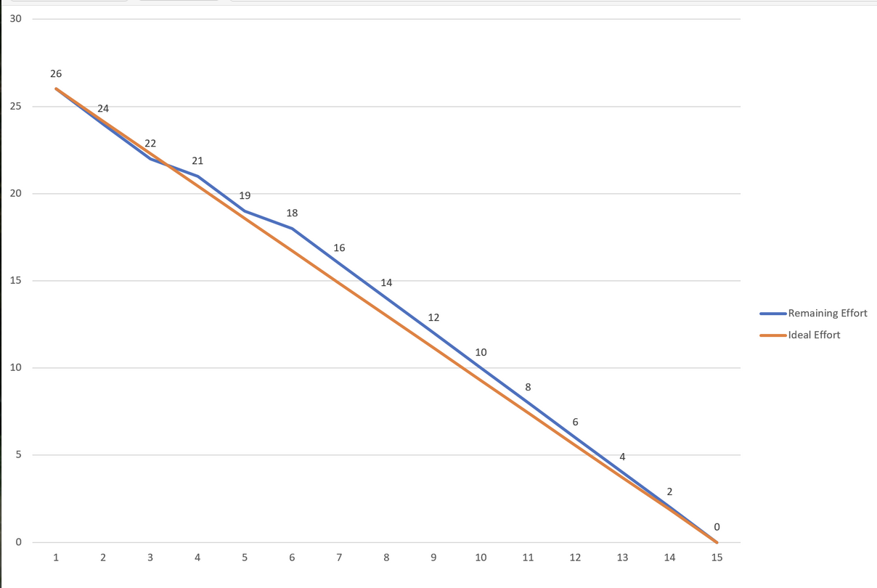
Sprint 5 Burn Down Chart

Slide 13
Project Updates
Forgot Password Functionality – Completed the forgot password feature and tested for bugs
Remember Me Box – Created a "Remember Me" box on the login page
Migration Planning Initiated – Migration strategy covering business, technical and staff readiness documented
Testing – Tested core system features to ensure no bugs

Slide 14
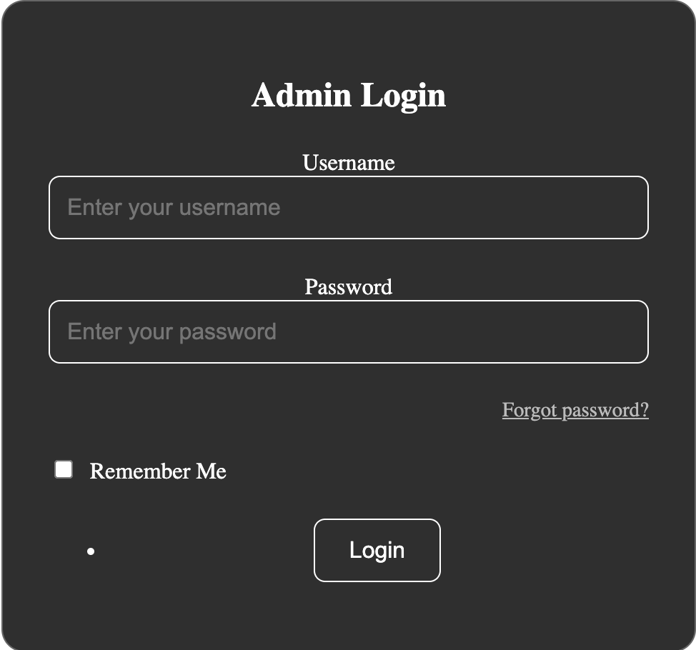
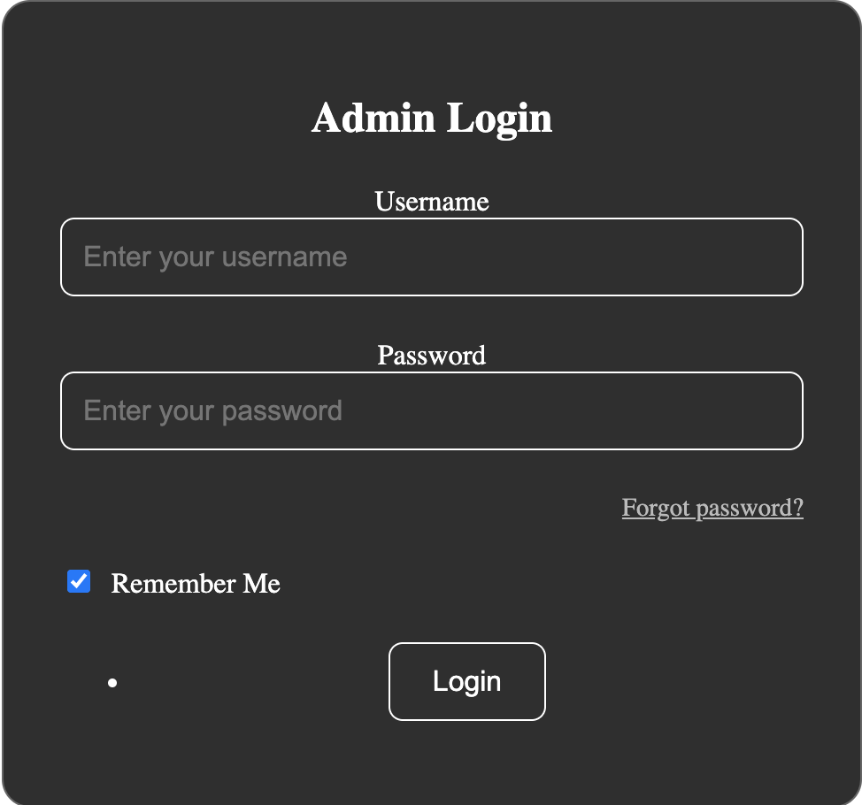
Sprint 5 PSPI
Remember Me Box

Slide 15
Questions?

